Slide 1

EVENT TICKET BOOKING SYSTEM USING BINARY SEARCH TREES
Presented By:
G.Ramya(192572073)
R.Varshini(192525349)
Guided By:
Dr.Kiruthika

Slide 2


Objective
Develop an online event ticket booking and management system.
Implement a Binary Search Tree (BST) for fast event searching and management.
Enable users to book, search, and cancel tickets efficiently.
Provide an admin panel to add, update, and delete event details.
Improve booking speed, accuracy, and overall user experience.

Slide 3
Literature Review
S.No | Title of the Paper | Publisher & Published Year | Components / Techniques Used
1 | A Blockchain-Based Generic and Reusable Ticket Booking Framework: Scalable Implementation Using AWS Cloud Infrastructure | SSRN, 2025 | Blockchain, AWS Cloud, Smart Contracts, NFT Tickets, API Gateway
2 | Enhancing Digital Identity and Access Control in Event Management Systems Using Sui Blockchain | IEEE Access, 2025 | Blockchain, Digital Identity, NFT Tickets, Secure Authentication, Event Management
3 | A Case Study on Online Ticket Booking System Project | SSRN, 2024 | HTML, CSS, JavaScript, PHP, MySQL, User Authentication, Booking Management
4 | Design and Development of a Web-Based Event Ticketing System Application | Universitas Hasanuddin Repository, 2024 | Web Application, Database Management, Event Booking, CRUD Operations

Slide 4
Problem Statement
Existing ticket booking systems become slow when searching through a large number of events.
Many systems do not use efficient data structures for fast event management.
Manual or inefficient booking processes can lead to delays and booking errors.
Updating event details and seat availability can be time-consuming.
There is a need for a fast, user-friendly, and efficient ticket booking system using Binary Search Trees (BST) to improve search and management performance.

Slide 5
Proposed Objectives
Develop a web-based event ticket booking and management system.
Implement a Binary Search Tree (BST) to enable fast event search, insertion, and deletion.
Allow users to easily search, book, and cancel event tickets online.
Provide an admin module to efficiently manage event details and seat availability.
Improve the speed, accuracy, and overall efficiency of the ticket booking process.

Slide 6
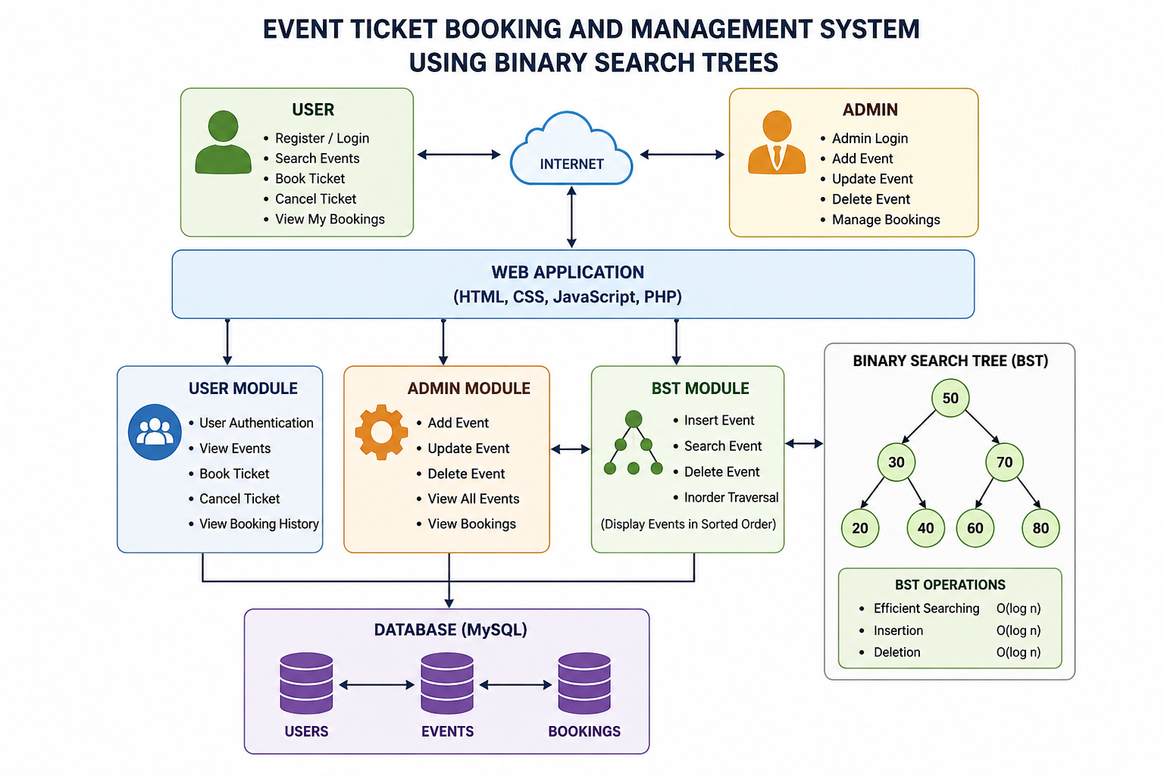
Architecture

Slide 7
Methodology
1.User Authentication :
Users register and log in to access the system.
Admin logs in to manage events and bookings.
2. Event Management:
Admin adds, updates, and deletes event details.
Event information is stored in the database.
3.BST Implementation:
Events are stored in a Binary Search Tree (BST) using Event ID as the key.
BST performs fast search, insertion, deletion, and traversal operations.

Slide 8
4.Ticket Booking
Users search for an event and book tickets if seats are available.
The system automatically updates the available seat count.
5.Ticket Cancellation
Users can cancel booked tickets.
Seat availability is updated after cancellation.
6.Database Management
User, event, and booking details are stored securely in a MySQL database.
7.Booking Confirmation
The system displays booking confirmation and maintains the user's booking history.

Slide 9
SDG
SDG 9 – Industry, Innovation and Infrastructure
Promotes digital event management.
Improves search efficiency using BST.
Reduces manual errors and processing time.
Encourages innovative use of data structures.
Provides a scalable and efficient booking system.

Slide 10
Conclusion
Developed a web-based Event Ticket Booking and Management System for efficient ticket reservations.
Implemented a Binary Search Tree (BST) to enable faster event searching and management.
Simplified the processes of booking, cancellation, and event management through an easy-to-use interface.
Improved system efficiency by reducing search time and maintaining accurate event and booking records.
The proposed system provides a reliable, scalable, and user-friendly solution for modern event ticket booking.

Slide 11
References
T. H. Cormen, C. E. Leiserson, R. L. Rivest, and C. Stein, Introduction to Algorithms, 4th ed. Cambridge, MA, USA: MIT Press, 2022.
M. T. Goodrich, R. Tamassia, and M. H. Goldwasser, Data Structures and Algorithms in Python. Hoboken, NJ, USA: John Wiley & Sons, 2021.
I. Sommerville, Software Engineering, 11th ed. Boston, MA, USA: Pearson, 2021.
Oracle Corporation, MySQL 8.0 Reference Manual, 2025. Available: https://dev.mysql.com/doc/
Mozilla Developer Network (MDN), Web Development Documentation, 2025. Available: https://developer.mozilla.org/

